Slide 1
2016 Mock Practical Exam

Slide 2
Question 1

Slide 4
Question 2

Slide 5
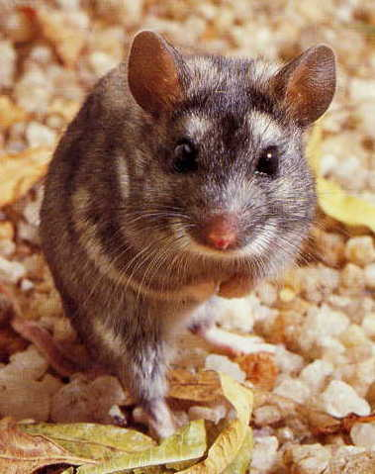
A
B
C
D

Slide 6
Question 3

Slide 7
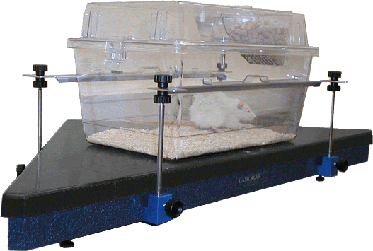

Slide 8
Question 4

Slide 9
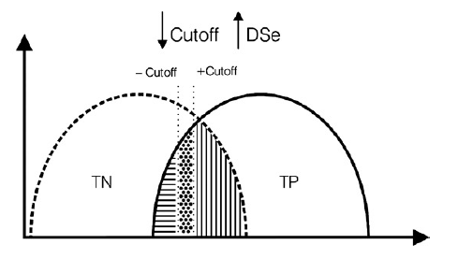

Slide 10
Question 5

Slide 11
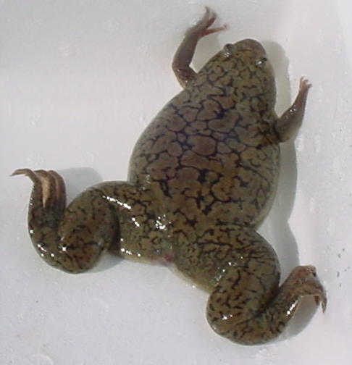

Slide 12
Question 6

Slide 13
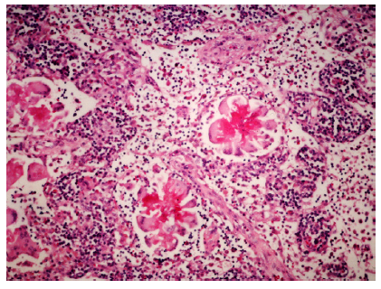

Slide 14
Question 7

Slide 15
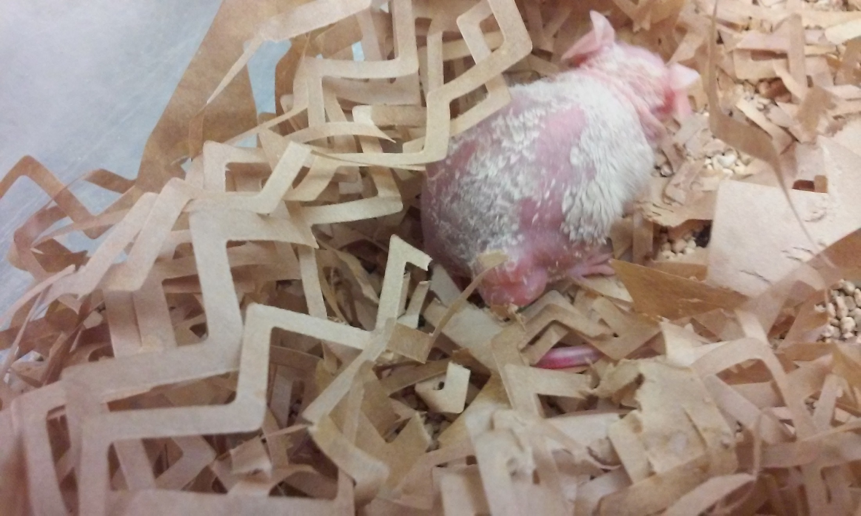

Slide 16
Question 8

Slide 18
Question 9

Slide 19
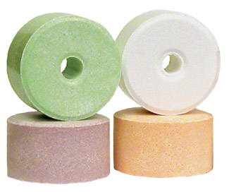

Slide 20
Question 10

Slide 21


Slide 22
Question 11

Slide 23
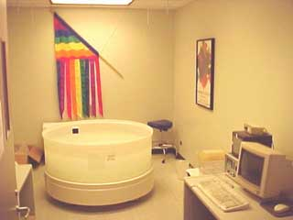
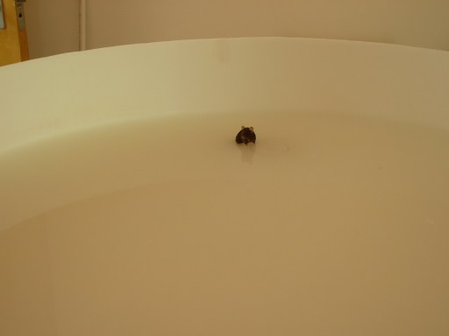

Slide 24
Question 12

Slide 25
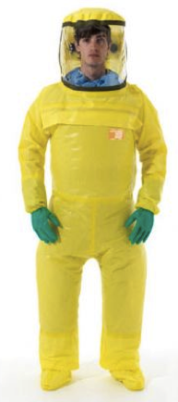

Slide 26
Question 13

Slide 27
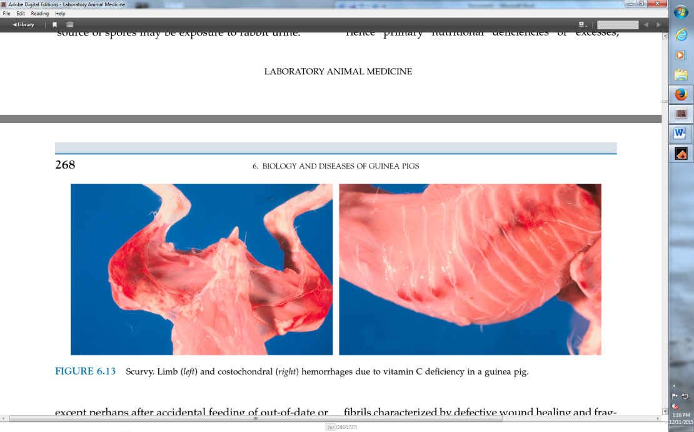

Slide 28
Question 14

Slide 29
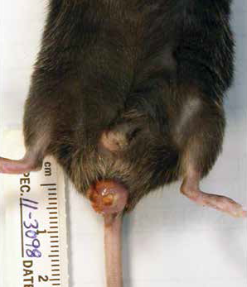

Slide 30
Question 15

Slide 31
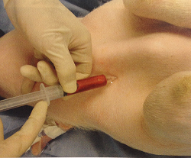

Slide 32
Question 16

Slide 33
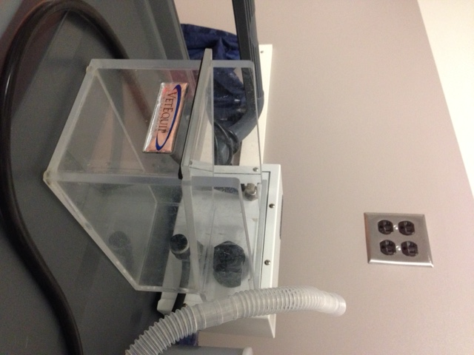

Slide 34
Question 17

Slide 35
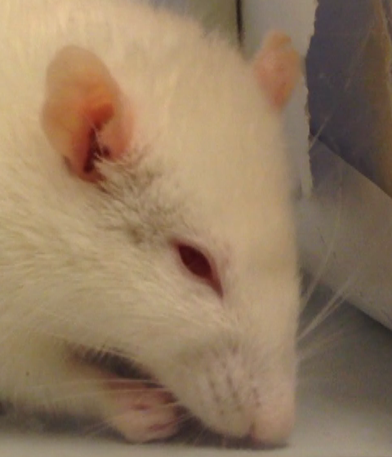

Slide 36
Question 18

Slide 37
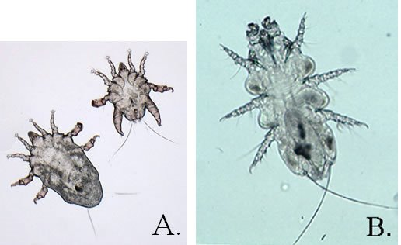

Slide 38
Question 19

Slide 39
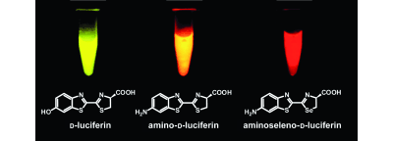

Slide 40
Question 20

Slide 42
Question 21

Slide 43
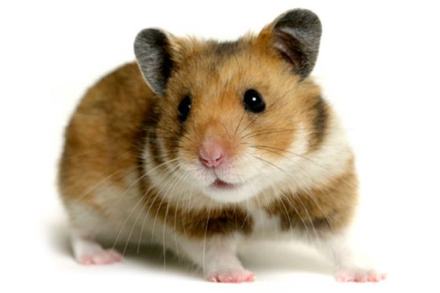

Slide 44
Question 22

Slide 45
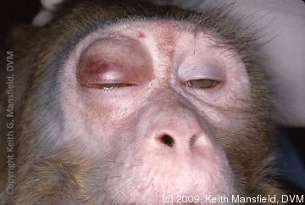

Slide 46
Question 23

Slide 47
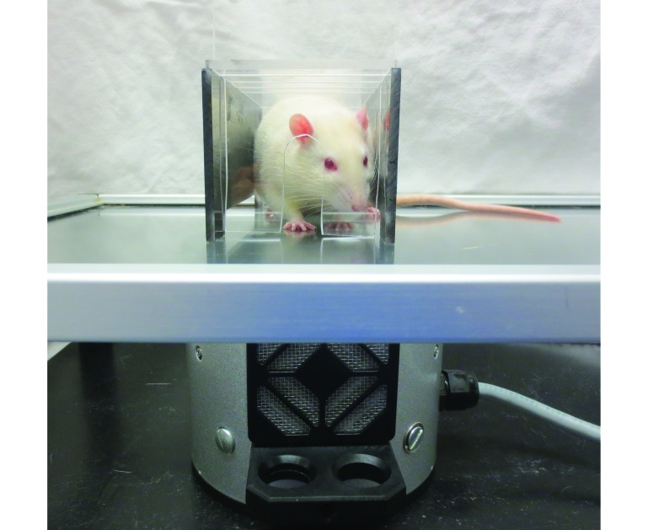

Slide 48
Question 24

Slide 49
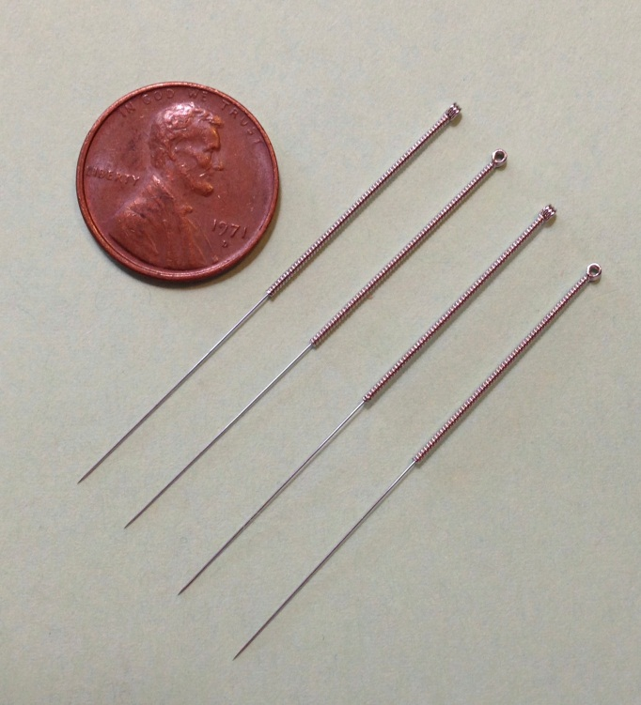

Slide 50
Question 25

Slide 51
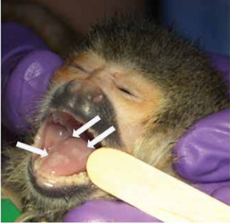

Slide 52
Question 26

Slide 53
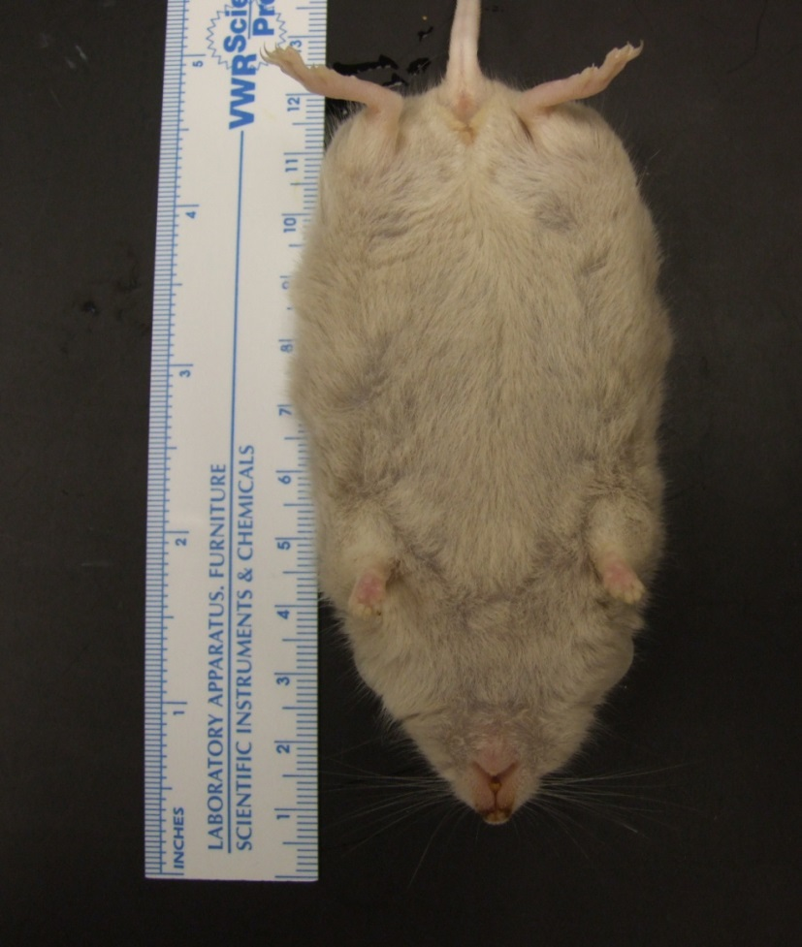

Slide 54
Question 27

Slide 55
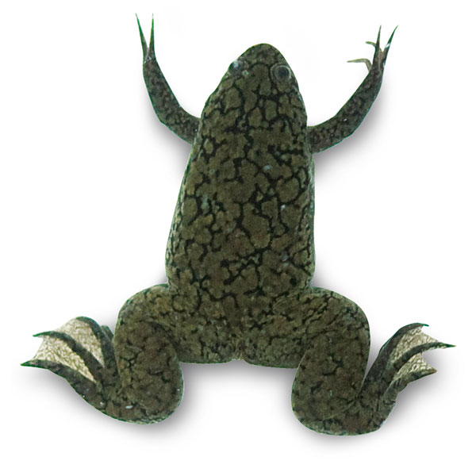

Slide 56
Question 28

Slide 57
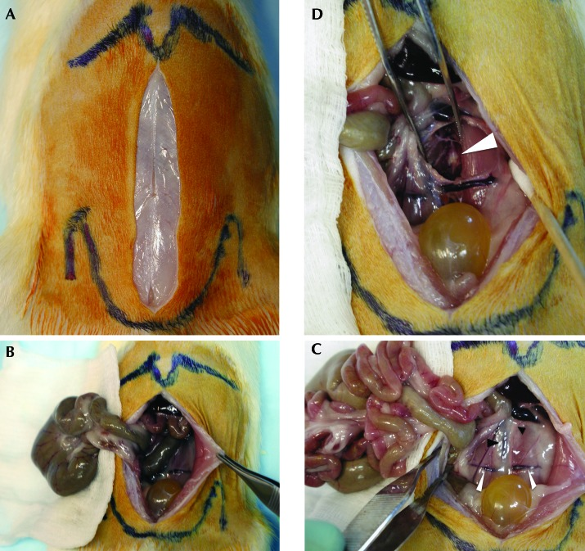

Slide 58
Question 29

Slide 59
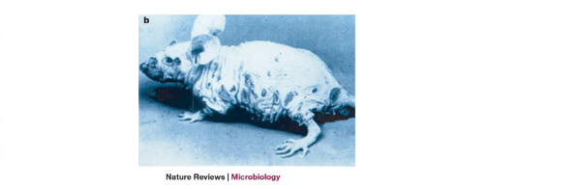

Slide 60
Question 30

Slide 62
Question 31

Slide 64
Question 32

Slide 66
Question 33

Slide 68
Question 34

Slide 69
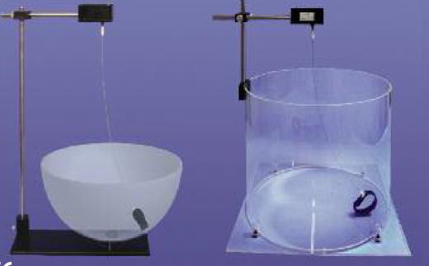

Slide 70
Question 35

Slide 71
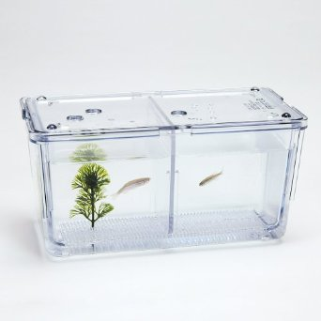

Slide 72
Question 36

Slide 73


Slide 74
Question 37

Slide 75


Slide 76
Question 38

Slide 77
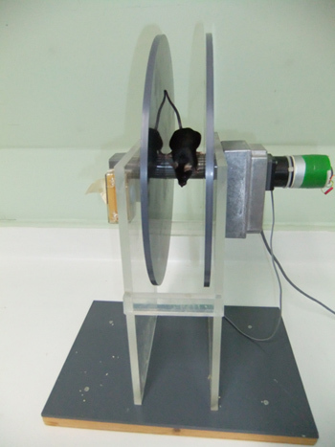

Slide 78
Question 39

Slide 80
Question 40

Slide 81
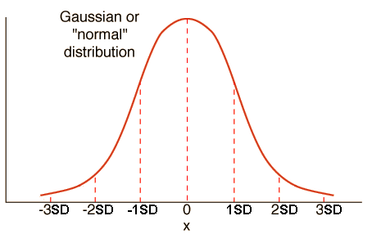

Slide 82
Question 41

Slide 83
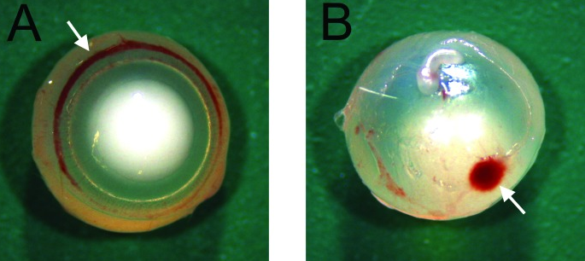

Slide 84
Question 42

Slide 86
Question 43

Slide 87
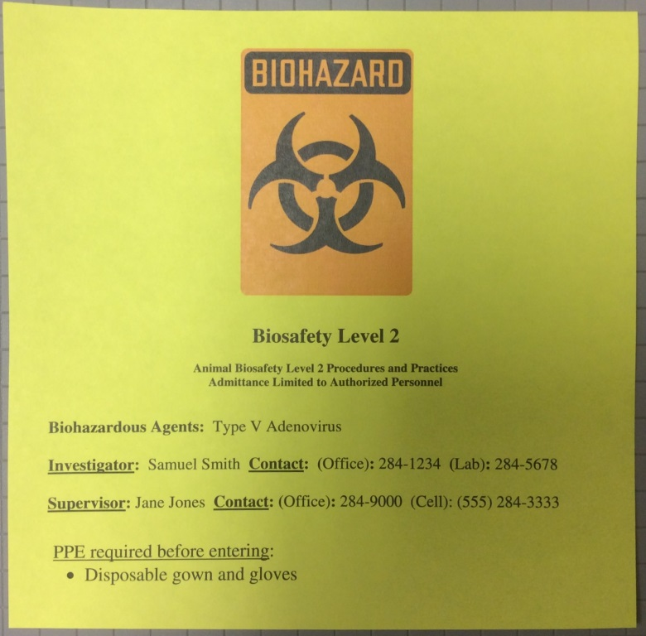

Slide 88
Question 44

Slide 89
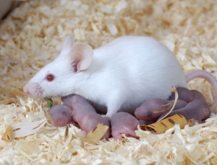

Slide 90
Question 45

Slide 91
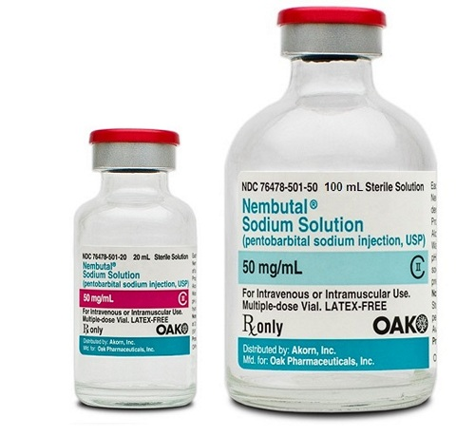

Slide 92
Question 46

Slide 93
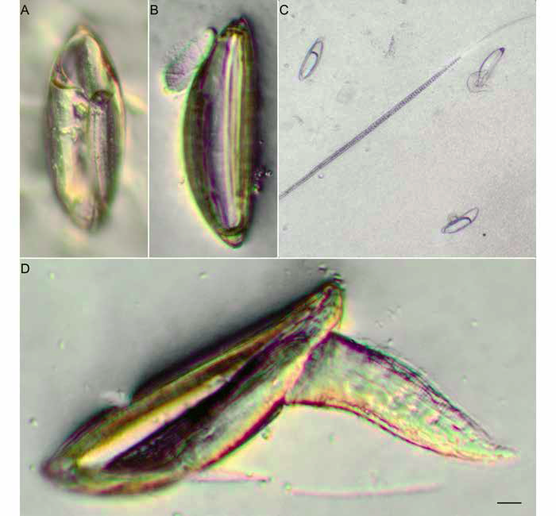

Slide 94
Question 47

Slide 95
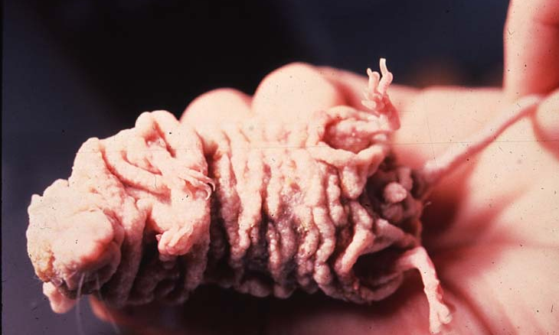

Slide 96
Question 48

Slide 97
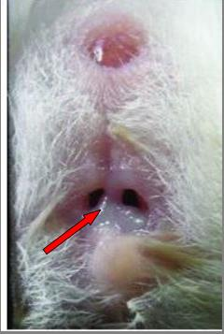

Slide 98
Question 49

Slide 99
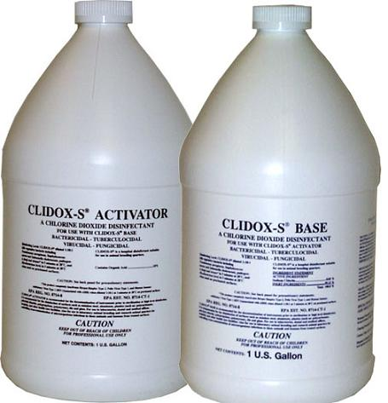

Slide 100
Question 50

Slide 102
Question 51

Slide 103
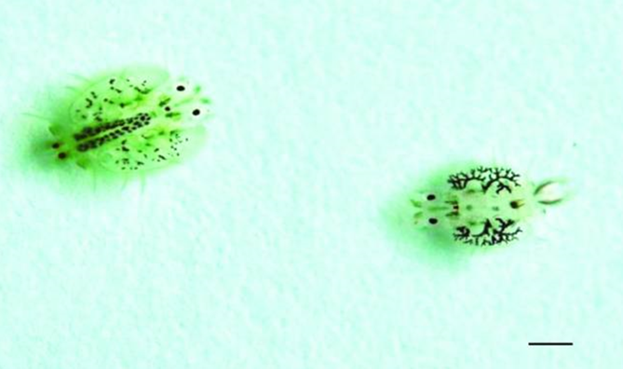

Slide 104
Question 52

Slide 105
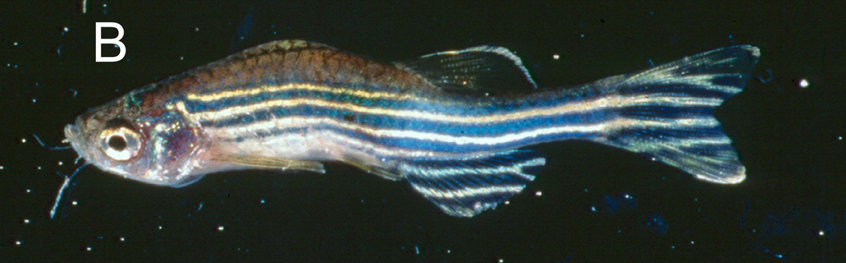

Slide 106
Question 53

Slide 107
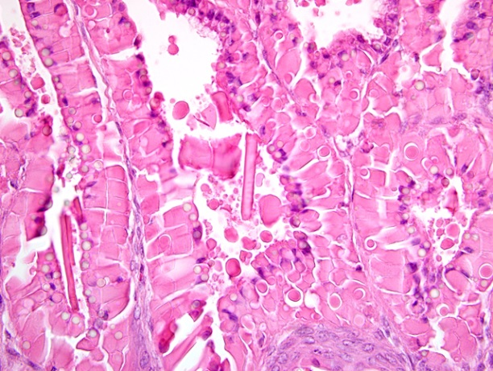

Slide 108
Question 54

Slide 109
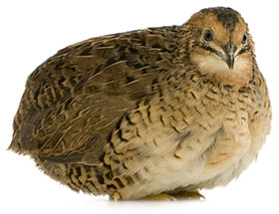

Slide 110
Question 55

Slide 111
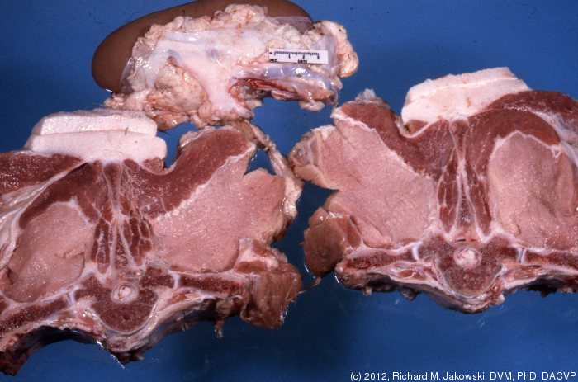

Slide 112
Question 56

Slide 113
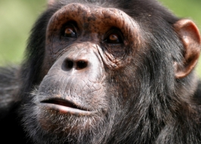

Slide 114
Question 57

Slide 115
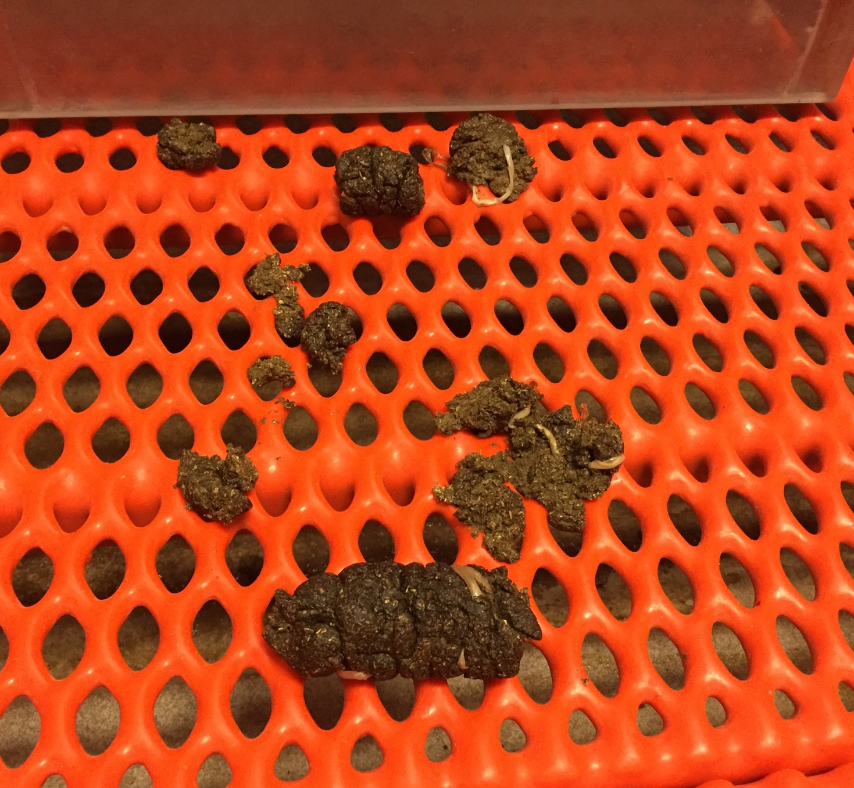

Slide 116
Question 58

Slide 117
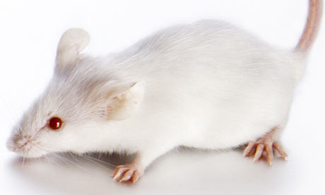

Slide 118
Question 59

Slide 119
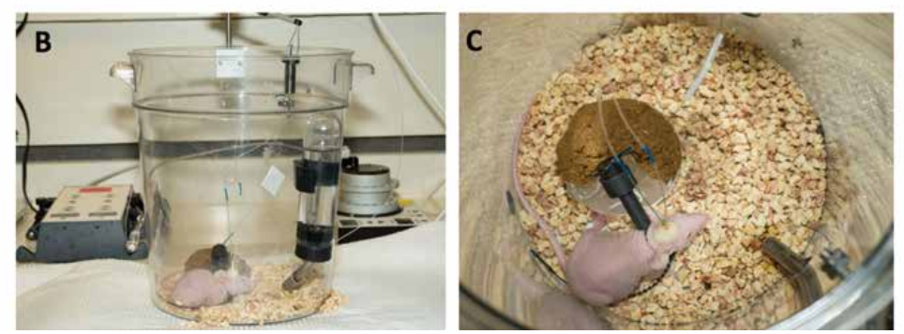

Slide 120
Question 60

Slide 121
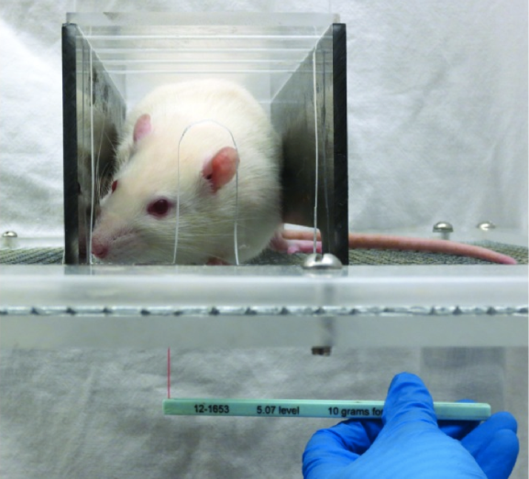

Slide 122
Question 61

Slide 123
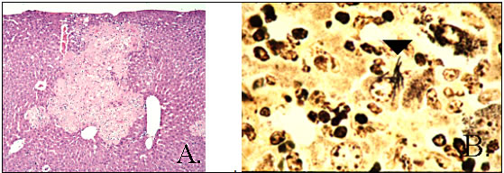

Slide 124
Question 62

Slide 125
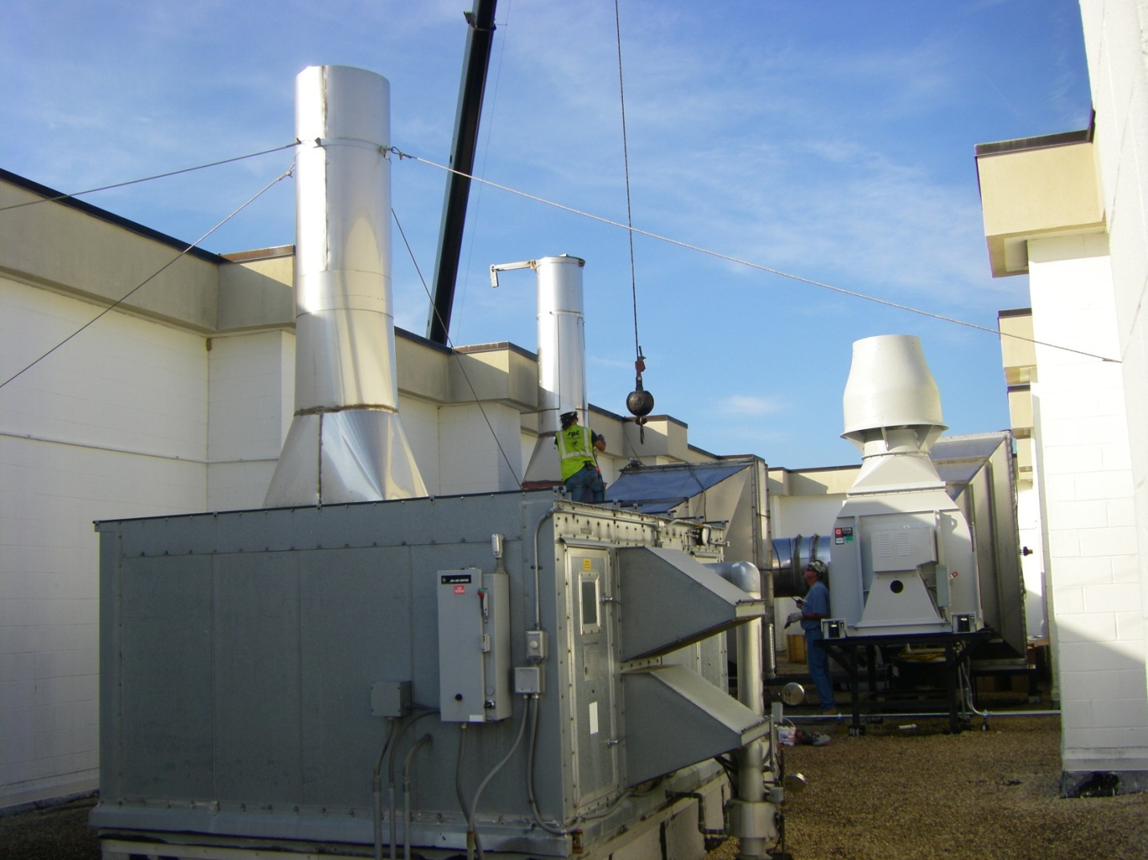

Slide 126
Question 63

Slide 127


Slide 128
Question 64

Slide 129


Slide 130
Question 65

Slide 131


Slide 132
Question 66

Slide 133


Slide 134
Question 67

Slide 135


Slide 136
Question 68

Slide 138
Question 69

Slide 140
Question 70

Slide 141


Slide 142
Question 71

Slide 143


Slide 144
Question 72

Slide 146
Question 73

Slide 147


Slide 148
Question 74

Slide 150
Question 75

Slide 151


Slide 152
Question 76

Slide 154
Question 77

Slide 155


Slide 156
Question 78

Slide 157


Slide 158
Question 79

Slide 159


Slide 160
Question 80

Slide 162
Question 81

Slide 163


Slide 164
Question 82

Slide 165


Slide 166
Question 83

Slide 167


Slide 168
Question 84

Slide 170
Question 85

Slide 171


Slide 172
Question 86

Slide 174
Question 87

Slide 175


Slide 176
Question 88

Slide 177


Slide 178
Question 89

Slide 179


Slide 180
Question 90

Slide 181


Slide 182
Question 91

Slide 183


Slide 184
Question 92

Slide 185


Slide 186
Question 93

Slide 187


Slide 188
Question 94

Slide 189


Slide 190
Question 95

Slide 191


Slide 192
Question 96

Slide 193


Slide 194
Question 97

Slide 196
Question 98

Slide 197


Slide 198
Question 99

Slide 200
Question 100

Slide 202
Question 101

Slide 203


Slide 204
Question 102

Slide 205


Slide 206
Question 103

Slide 207


Slide 208
Question 104

Slide 210
Question 105

Slide 211


Slide 212
Question 106

Slide 213


Slide 214
Question 107

Slide 215


Slide 216
Question 108

Slide 217


Slide 218
Question 109

Slide 219


Slide 220
Question 110

Slide 222
Question 111

Slide 223




A
B
C
D

Slide 224
Question 112

Slide 225


Slide 226
Question 113

Slide 227


Slide 228
Question 114

Slide 229


Slide 230
Question 115

Slide 231




A
B
C
D

Slide 232
Question 116

Slide 233


Slide 234
Question 117

Slide 235


Slide 236
Question 118

Slide 237



Slide 238
Question 119

Slide 239


Slide 240
Question 120

Slide 241


